Slide 1
Lecture 35
Application Design

Slide 2
Memory Management
Android is designed to manage memory (RAM) to keep power consumption at a minimum, in contrast to desktop operating systems which generally assume they are connected to unlimited.
When an Android app is no longer in use, the system will automatically suspend it in memory – while the app is still technically "open“.
Android manages the apps stored in memory automatically.
When memory is low, the system will begin killing apps and processes that have been inactive for a while.
This process is designed to be invisible to the user, such that users do not need to manage memory or the killing of apps themselves.
Android Runtime (ART) and Dalvik virtual machine use paging and memory-mapping to manage memory.

Slide 3
Memory Management
Like Java and .NET, Android uses its own run time and virtual machine to manage application memory.
Android run time also manages the process lifetimes.
Android ensures application responsiveness by stopping and killing processes as necessary to free resources for higher-priority applications.
Each Android application runs in a separate process within its own Dalvik instance for memory and process management to the Android run time, which stops and kills processes as necessary to manage resources.
Dalvik and the Android run time sit on top of a Linux kernel that handles low-level hardware interaction including drivers and memory management.

Slide 4
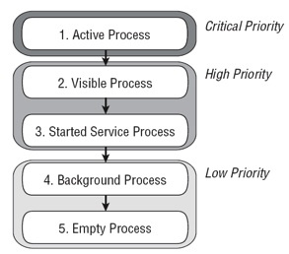
Application Priority and Process States

Slide 5
Application Priority and Process States
Active (foreground) Processes:-
Which processes are currently interacting with the user but they will be killed only as a last resort.
Visible Processes:-
Which are Visible, but inactive processes.
They’ll only be killed to allow active processes to continue.
Started Service Processes:-
Services support ongoing processing that should continue without a visible interface.
Because Services don’t interact directly with the user, they receive a slightly lower priority than visible Activities.
They are still considered to be foreground processes and won’t be killed unless resources are needed for active or visible processes.
Background Processes:-
That aren’t visible and that don’t have any Services.
There will generally be a large number of background processes that Android will kill using a last-seen-first-killed pattern to obtain resources for foreground processes.
Empty Processes:-
To improve overall system performance, Android often retains applications in memory after they have reached the end of their lifetimes.
Android maintains this cache to improve the start-up time of applications when they’re re-launched. These processes are routinely killed as required.

Slide 6
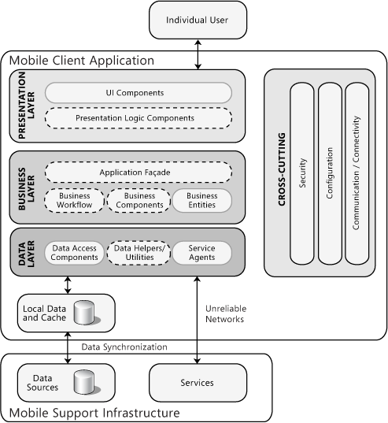
Mobile Application Architecture Work Flow for Application Development

Slide 7
Design Pattern for Limited Memory
Mobile application development is a challenging task for the software companies because of limited memory in mobile.
We have to use a specific pattern for using limited memory for maximum performance.
Firstly Prepare a memory budget.
Design a software architecture and component interfaces to minimize memory use.
Track memory consumption through the development process

Slide 8
Dynamic Linking in Memory Management
Memory management is the functionality of an operating system which handles or manages primary memory.
Memory management keeps track of each and every memory location, regardless of either it is allocated to some process or it is free.
It checks how much memory is to be allocated to processes.
It allocates the memory to process.
It de-allocates the memory from process.

Slide 9
Dynamic Linking in Memory Management
Static vs Dynamic Loading:-
The choice between Static or Dynamic Loading is to be made at the time of computer program being developed.
If you have to load your program statically, then at the time of compilation, the complete programs will be compiled.
The linker combines the object program with other necessary object modules into our program, which also includes logical addresses.
If you are writing a Dynamically loaded program, then your compiler will compile the program and for all the modules which you want to include dynamically, only references will be provided and rest of the work will be done at the time of execution.
At the time of loading, with static loading, the absolute program (and data) is loaded into memory in order for execution to start.
If you are using dynamic loading, dynamic routines loaded into memory only when they are needed by the program.

Slide 10
Dynamic Linking in Memory Management
Static vs Dynamic Linking:-
When static linking is used, the linker combines all other modules needed by a program into a single executable program to avoid any runtime dependency.
When dynamic linking is used, it is not required to link the actual module or library with the program, rather a reference to the dynamic module is provided at the time of compilation and linking.
Dynamic Link Libraries (DLL) are good examples of dynamic libraries.

Slide 11
Dynamic Link Libraries (DLL)
Dynamic-link library (or DLL) is Microsoft's implementation of the shared library concept in Operating-System.
These libraries usually have the file extension DLL, OCX, DRV etc.
The file formats for DLLs are the same as for Windows EXE files.
As with EXEs, DLLs can contain code, data, and resources, in any combination.
A dynamic link library (DLL) is a collection of one or more functions or variables in an executable module that is executable or accessible from a separate application module.
In an application without DLLs, all external function and variable references are resolved statically at bind time.
In a DLL application, external function and variable references are resolved dynamically at run time.

Slide 12
Dynamic Link Libraries (DLL)
Types of DLL:-
There are two types of DLLs: simple and complex.
A simple DLL contains only DLL code.
A complex DLL contains mixed code, that is, some DLL code and some non-DLL code.
Features of DLL:-
Memory management
Import libraries
Symbol resolution and binding
Explicit run-time linking
Delayed loading

Slide 13
Dynamic Link Libraries (DLL)
DLL support is available for applications running under the following systems:-
z/OS® batch
CICS
IMS
TSO
z/OS UNIX
It is not available for applications running under SPC, CSP or MTF.
The entry point for a DLL must be either z/OS® C/C++ or other supported Language Environment.
In a DLL application that contains main(), main() cannot be exported.
You cannot use the functions set_new_handler() or set_unexpected() in a DLL .
Use of circular DLLs may result in unpredictable behavior

